Slide 1
Infusing Heterogeneous Data to Troubleshoot & Improve Peering Performance and Security
Some Use Cases
Siarhei Matashuk
CCIE #27340
May 2025
Notes:
Muchas gracias a los organizadores por el evento y la maravillosa velada

Slide 2
“BGP Routing Tasks”
Peering Coordinators, Network Engineers for BGP Operation……
Peering Evaluation: Align peering decisions with your policy
Traffic Route Management: Monitor traffic paths to optimize routing, detect anomalies, and troubleshoot issues.
Route Health Monitoring: Use BGP updates and RPKI validation to assess route stability and integrity.
Route Anomaly Detection: Enable proactive alerts for abnormal BGP behavior.
“Anything you need to quantify can be measured in some way that is superior to not measuring it at all.” —Gilb's Law: Collect and fuse network data from multiple sources

Slide 3
Peering Evaluation
To Peer or Not to Peer, That’s the Question
Align with your peering policy:
No Peering: Focus on choosing the best transit providers for cost-efficiency.
Pick providers who are best for your specific traffic
Open: Peer with as many networks as possible to reduce transit costs.
To decide if you should peer with a new network
To convince others to peer with you
Selective: Only peer with networks that offer significant mutual value.
To decide if you should peer with a new network
Restrictive: Assess potential customer traffic for transit business revenue opportunities.
To understand 'transit prospective customers’ traffic behavior for compelling business case building
Notes:
The ultimate question is not where DO you route your traffic, it is where CAN you route your traffic.
Why we Peer?
For Performance (lower latency and better throughput to end users),
for Capacity (more bandwidth than current paths),
for Redundancy (multiple paths into your networks),
for Cost reduction (transit saving, reduction of of backbone usage in your network.)
What to consider:
What markets and networks does your traffic come from? Where is it going?
Does your network architecture/hardware allow you to expand into many or few sites?
Have facts and figures of your network profile - You may have a "feeling", but is your company going to spend millions of dollars on a feeling?
Use telemetry-based tools to find out for sure, you may be surprised.
Create a list of top networks that you exchange traffic with that you are not currently peering with, and rank them by amount of traffic.

Slide 4
Open Peering Policy Use Case
Use Case
Goal: Find and evaluate new peering candidates
Identify the Candidates: Settlement-free peering reduces transit costs by enabling direct exchange of traffic, bypassing third-party transit providers.
Cost Analysis: While the peering arrangement itself is settlement-free, it still incurs infrastructure costs such as router port utilization and colocation expenses at the peering facility.
Steps:
Identify ASNs with significant traffic volume not yet peered with: Rank the ASNs based on the volume of exchanged traffic
Identify ASNs with a balanced traffic ratio: where the inbound and outbound traffic volumes are approximately equal. A roughly equal exchange makes the peering relationship more sustainable and likely to be accepted
Distinguish between direct traffic (sent to/from) and through traffic (through, transit paths) (sent to/from or through): If the ASN is just a transit provider or intermediary (i.e., you’re sending traffic through it to reach others), then peering with it might not yield much benefit.
Notes:
Steps:
Evaluate traffic to all ASNs, exclude those with existing peering relationships, and rank the remaining ASNs based on the volume of exchanged traffic
Identify ASNs with a balanced traffic ratio—where the inbound and outbound traffic volumes are approximately equal (as it shows that both networks benefit equally from the connection. A roughly equal exchange makes the peering relationship more sustainable and likely to be accepted)
Analyze the traffic pattern (sent to/from or through) — peering is about direct exchange of traffic between your network and the candidate’s ASN. If the ASN is just a transit provider or intermediary (i.e., you’re sending traffic through it to reach others), then peering with it might not yield much benefit.

Slide 5
Open Peering Policy Use Case (contd)
Use Case
Estimate cost savings vs. infrastructure cost:
Cost Avoidance from Transit: how much transit cost would be saved if the traffic is offloaded
Example: If you’re paying $X and $Y per Mbps for transit A and B, and this peering would offload m and n Mbps, you can estimate monthly savings [ $(m·X + n·X)]
Peering Intra Cost: Calculate the port & colocation cost for establishing the new peering
Do you already have infrastructure (routers, ports, power, rack space) at the same IX where the candidate ASN peers?
If yes, the incremental cost is lower
If not, factor in additional port costs (e.g., 10G, 100G) and rack/power/cross-connect fees.
A simplified cost-benefit formula like:.
Net Benefit = (Transit Cost Saved) – (Peering Infra Cost + Operational Overhead)
If Net Benefit is positive and rising over time → go for it.
Indirect benefits - User Experience
Notes:
Now the important part, find out whether it makes sense for you to expand your network in order to peer
Get quotes from colocation providers and transport providers and compute how much it’s going to cost to build a new POP.
•Divide that cost by how much traffic you believe you will be able to peer.
•If that cost is lower than how much you pay for transit, you have a good case to expand your network.
•Transit may cost less. It’s not always cheaper to peer.
•Consider other factors like performance, redundancy, ability to meet previously unattainable peering policies.

Slide 6
Peering Evaluation
Not just for Open Peering. Evaluation helps across all policy types:
No Peering: Cost analysis can also help Choose the most efficient transit providers for your specific traffic
Selective: Assess whether peering requests make sense based on traffic volume, traffic ratio and traffic patterns
Restrictive: Understand potential customer traffic to build a business case
Use data to support decisions: Flow data: Understand traffic volume and directionality BGP data: Analyze prefix visibility, AS paths, and routing dynamics (build your own virtual RIB)

Slide 7
Traffic Route Management
Traffic Engineering Use Cases
Knowing What traffic is leaving/entering your network @where is helpful for adjusting how the traffic going across the network.
Congestion mitigation: Identify which links or peers are overloaded
Exit point balancing: Shift traffic using BGP policies (e.g., LOCAL_PREF)
Policy verification: Ensure that configuration changes are effective
Route integrity: Detect route leaks or peers violating traffic agreements
Key Data Sources:
Flow records: traffic volume, interface mapping, etc.
BGP updates: prefix paths, next-hop, etc.
SNMP: interface utilization, etc.
Notes:
Information Helps the Job Done
Knowing “what traffic” is leaving the network @“where” provides insights for adjusting traffic going across the network
- If you know how much traffic is going to an AS, an AS Path, a BGP Community, or a Next-hop, you can use various methods (route policy) to deterministically move the traffic around.
- Data aggregation across the set of interfaces/links
■ Effective Actions Based Upon the information
● Static route
● Apply route policy to engineer traffic around
- Apply BGP policy (e.g. LOCAL_PREF, MED, AS_PATH) to routes seen from specific ASNs to prefer one peer interface over another
● Exit selection (outbound control) is a reasonably precise science

Slide 8
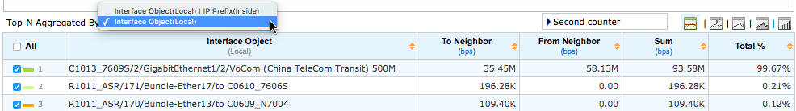
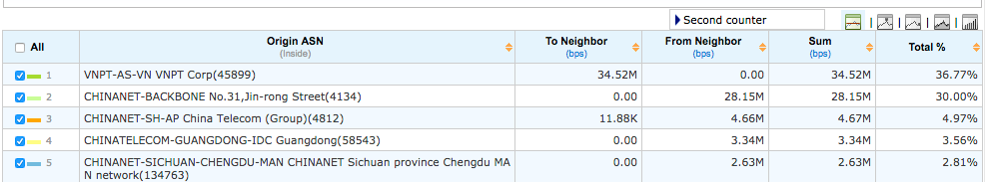
Congestion Mitigation by Exit Point Balancing
Use Case
A Use Case to mitigate congestion and improve resource utilization
Example: A peer (ISP V) is complained “being saturated.” So let’s see what is going on there:
Knowing only how much total traffic there is through ISP-V is not enough
Need to know the traffic through and the utilization of all the links connecting to ISP-V
3 exit points to reach ISP-V
Currently most thru router C1’s link
Want to shift some traffic to other links
Whose traffic shall be shifted?
Interface traffic distribution on a specific BGP peer
Apply route policy with actual measurements
We may move certain share of traffic (e.g. 30%, which is pretty much a specific ASN’s traffic) from one interface (C’s1) to another (ASR’s) by BGP methods (e.g., LOCAL_PRF)
Origin ASN distribution on a specific BGP peer
Notes:
(p.38) By looking at how much traffic is going out to specific ASNs, you can apply policy to routes seen from specific ASNs to have your networks prefer one peer interface over another. Local preference can be used to deterministically move traffic from one peer interface to another provided both have access to the same ASN.
(p.15, 16) Local Preference：Affecting How Traffic Leaves Your AS
Information Helps the Job Done
Knowing “what traffic” is leaving the network @“where” provides insights for adjusting traffic going across the network
- If you know how much traffic is going to an AS, an AS Path, a BGP Community, or a Next-hop, you can use various methods (route policy) to deterministically move the traffic around.
- Data aggregation across the set of interfaces/links
■ Effective Actions Based Upon the information
● Static route
● Apply route policy to engineer traffic around
- Apply BGP policy (e.g. LOCAL_PREF, MED, AS_PATH) to routes seen from specific ASNs to prefer one peer interface over another
● Exit selection (outbound control) is a reasonably precise science

Slide 9





BGP Policy Validation
Use Case
Troubleshooting — Expected route shifts don’t happen
Suboptimal BGP policy setting: for verifying whether we have made all configuration changes as we expected to facilitate the expected traffic route changes
In order to offload the regional network’s Internet traffic from the busy link connecting the regional network with its domestic backbone, the SP has added an exit link from the regional network to the Internet directly.
Internet Exit
Internet
Busy Link to offload
D
Real Traffic
Even though the corresponding configuration changes were considered done, the regional network is found still routing most of its Internet traffic through the link to the domestic backbone, wasting the domestic backbone resources. It turned out that some BGP policies were not changed along correctly…
S
Regional Network
Domestic Backbone
Notes:
Identify unreasonable routed traffic
Mis-configured routing policy, Theft-over-IP, etc.
Ex. Un-optimized peering policy (no-export on certain long prefixes…)
In a China Telecom’s case is that a Provincial ISP found that some of its subordinate cities are using its exit links to access the telecom’s domestic backbone. This is unreasonable because after some network building projects, the city-level networks have their direct link to the domestic backbone already. So that the traffic transiting through the provincial network to the backbone instead of peer with the backbone directly is not routing optimized. In the case, the network manager found that its some routing policy issues and hence worked to fix it.

Slide 10

Route Integrity Verification
Use Case
Troubleshooting — Unreasonable peer behavior
Example: Peers dumping traffic at you for routes they didn’t receive from you (CDN/service providers abusing peering terms)
Instead of diverting the traffic through paid transit links, ISP B dumps traffic at ISP A for routes ISP A didn’t send it trough the free-peering agreement.
ISP B is stealing resources from ISP A, by violating the peering agreements with ISP A.
ISP A
Transit Link
Subscribers/
Eyeball networks
Peering Link
Expected Traffic
$$
Real Traffic
ISP B/
CDN/ Content Provider
Have facts and figures for identifying and evidencing these unreasonable routes: Correlate service (CDN, OTT, etc.) identity information can be also helpful, in the cases that ISP B is a CDN network or service provider who’s traffic cannot be identified via origin ASN…

Slide 11
Route Health Monitoring
Analyze BGP Route Instability
By examining BGP route status changes received from peers, BMP data, and correlation with RPKI information, we can analyze BGP route instability. The route status events reflect the internal BGP decision-making process. Analyzing them may help:
Detect flapping routes or unstable prefixes,
Identify problematic peers
Trace the root cause behind frequent route changes (e.g., upstream instability, policy change, implementation bugs)
Possible Data Sources
BGP routing messages (updates from peers): Such as UPDATE messages with NLRI, Withdrawn Routes, associated BGP attributes (AS_PATH, NEXT_HOP, Communities, etc.)
BMP messages (from the routers’ perspective): per-peer per-prefix events like AAdiff, Wdown, Status transitions (Tbetter, Wdown, etc.)
RPKI validation status: prefixes can tagged with RPKI status (valid/invalid/unknown status, etc.)
Notes:
To analyze BGP route instability, examining BGP route status changes received from peers or routers is very effective. These route status events reflect the internal BGP decision-making process—such as path selection, withdrawal, replacement, and forwarding changes. Analyzing them helps you:
Detect flapping routes or unstable prefixes
Identify problematic peers
Understand the reasons behind frequent route changes
Trace the root cause (e.g., upstream instability, policy change, implementation bugs)

Slide 12
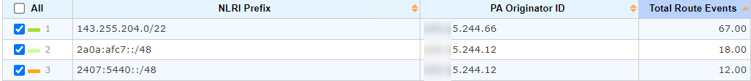
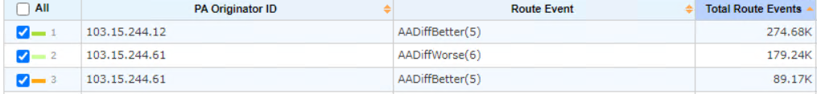
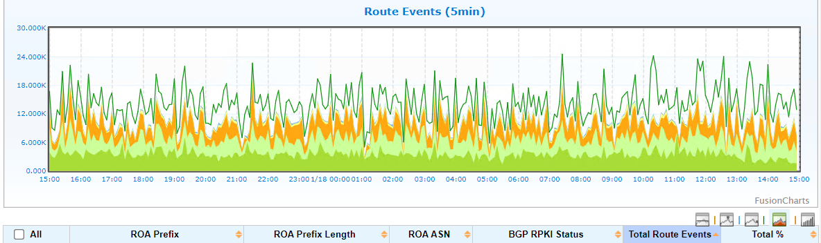
Route Health Monitoring
Monitoring Examples
BGP: Monitor the Top-N prefixes with the highest event count (especially Wdown/TW), etc.
By Peer: Track which peers cause the most TW/Wdown events, etc.
Time-based: Are the events clustered in short bursts (bursty behavior)? Do they happen at regular times (e.g., scheduled policy updates or cron jobs)?
Notes:
To analyze BGP route instability, examining BGP route status changes received from peers or routers is very effective. These route status events reflect the internal BGP decision-making process—such as path selection, withdrawal, replacement, and forwarding changes. Analyzing them helps you:
Detect flapping routes or unstable prefixes
Identify problematic peers
Understand the reasons behind frequent route changes
Trace the root cause (e.g., upstream instability, policy change, implementation bugs)

Slide 13
Route Anomaly Detection
Some BGP Route Anomaly Alerting Ideas
A BGP peer monitored by BMP goes up and down: Indicate BGP peer flapping, which triggers frequent route-convergence and generates a massive churn of BGP messages. Example: detect > N times Peer flaps (Up/Down) in M minutes
BGP route state changes while RPKI invalid: Invalid routes should be rejected (depending on policy.) If invalid routes cause replacement of valid paths, hijack or misconfig is likely. Example: detect > N route change events (Add, Withdraw, Replace, Fail Over) while RPKI invalid (INVALID_ASN or INVALID_LENGTH) in M minutes
Unstable routes: For a prefix, if too many route change events in short time window, it may suggest route flapping (instability) due to upstream routing churn, BGP convergence churn due to remote outages, Intermittent RPKI status flips (valid <-> invalid), etc. Example: detect > N times route flaps (Replace, Fail Over) in M minutes
Too frequent route announcements from a BGP router: It could be a route leak or policy Misconfiguration, a BGP Speaker Misbehaving, a Prefix Hijack or Attack, etc. Example: detect > N times announcement events in M minutes
Notes:
GenieATM will detect the following route issues and sends alerts:
BGP peer up/down (the BGP peer monitored by BMP goes up and down. Usually along with a lot of Delete Route and Add Route events)
Route change while RPKI invalid: Add / Delete / Replace Route or Fail-over routes while RPKI is invalid (invalid_asn or invalid_length); RPKI invalid causes route changes (operation is to change the path attribute (Replace Route or Fail Over), or Add / Delete Route)
Unstable routes due to too many route change events (Replace / Fail Over) in a short time
Unusual route announcements: too many route announcements from a BGP Router in a short time

Slide 14
Key Takeaways
Key Tasks Empowered by BGP Telemetry Analysis
Peering Evaluation: Identify valuable candidates; assess cost-benefit
Traffic Route Management: Balance, optimize, and validate routing paths
Route Health Monitoring: Detect flapping, problematic peers, misconfigurations
Route Anomaly Detection: Alert on abnormal route behaviors
Use heterogeneous data: Flow records, BGP routes, SNMP, service layer info (DNS info), RPKI validation and BMP telemetry to help the tasks done more effectively and efficiently!

Slide 15
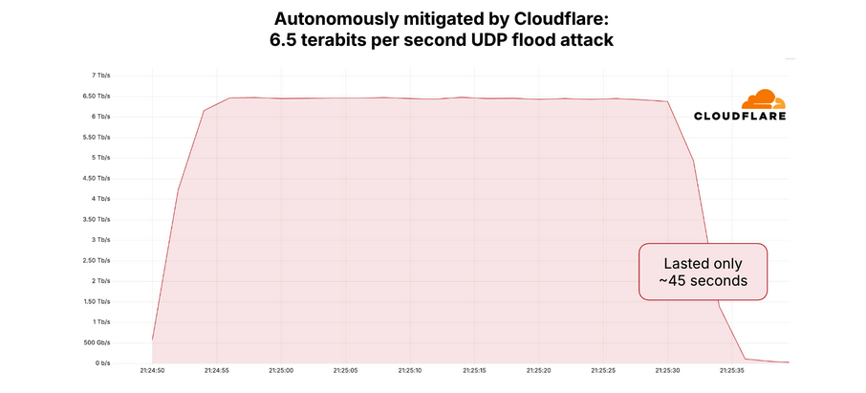
DDoS attacks up 358% year-over-year
KrebsOnSecurity last week was hit by a near record distributed denial-of-service (DDoS) attack that clocked in at more than 6.3 Tbps.
Google Security Engineer Damian Menscher told KrebsOnSecurity the May 12 attack was the largest Google has ever handled.
After comparing notes with Cloudflare, Menscher said the botnet that launched both attacks bears the fingerprints of Aisuru, a digital siege machine that first surfaced less than a year ago.
Sub-minute 6.5Tbps attacks using UDP originated from 147 countries and targeted multiple IP addresses and ports of a hosting provider.
Notes:
Muchas gracias a los organizadores por el evento y la maravillosa velada

Slide 16
What can you do?
Use flow tools to ensure traffic visibility you can't afford to be blind.
Know your upstream/IX AntiDDoS capabilities:
RTBH
Advanced RTBH
FlowSpec
Upstream scrubbing
Clean Pipes
Maintain a list of emergency contacts for quick response.
Communicate, share, and collaborate with your peers.

Slide 17

Siarhei Matashuk
www.genie-networks.com
s.matashuk@genie-networks.com

